Slide 1


NIH supported Science Education Partnership Award (SEPA) Program for Student internships (2023-2028)
(NIH-SEPA award # 1R25GM150141-01; NNR-23.486)
CONVOY: A Cultural Approach of Navajo Youth to Bio- Medical Sciences

Slide 2
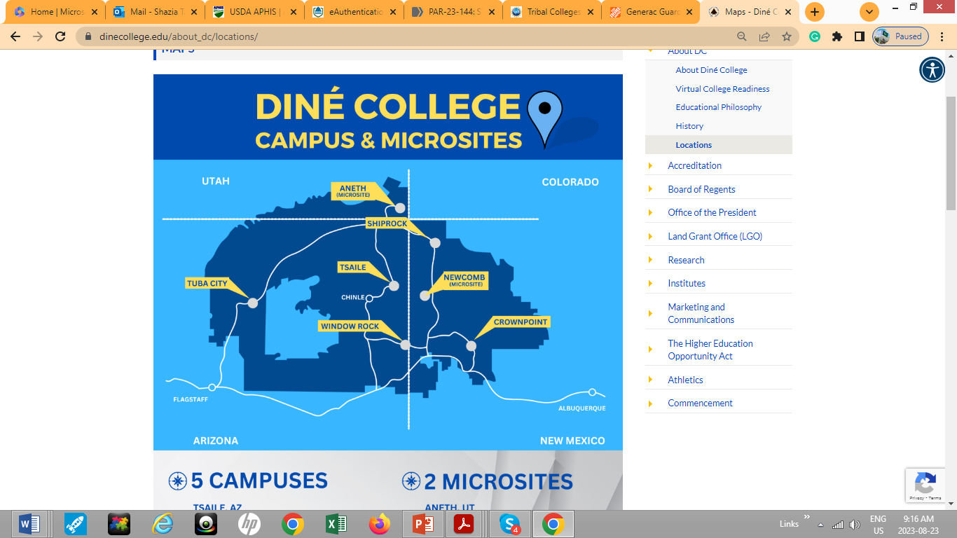

Slide 3
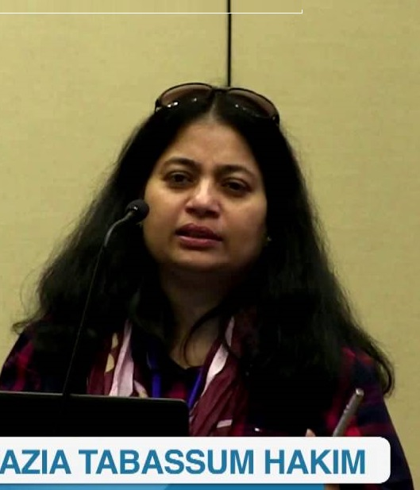

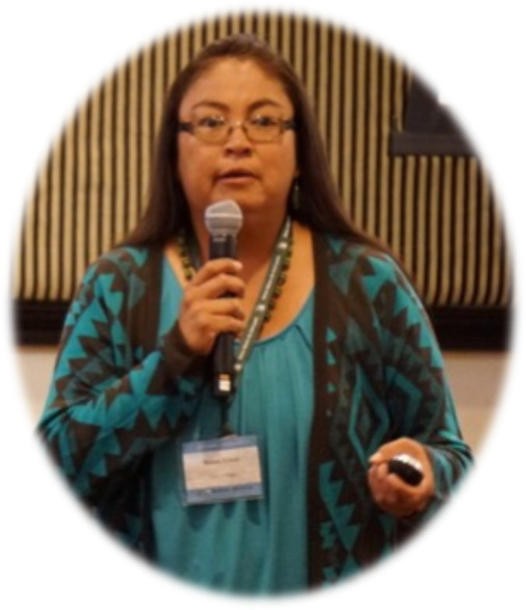
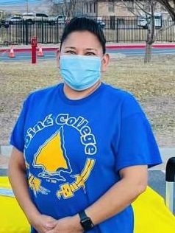
Who we are??? The team CONVOY!
Prof. Dr. Shazia Tabassum Hakim
(DC-Principal Investigator
Biomedical Sciences)
Prof. Dr. Babatunde Ojo
(DC-Co-Investigator
Chemistry)
Ms. Benita Litson
(DC-Co-Investigator
Land Grant Office)
Ms. Francetta Begaye
(DC-Co-Investigator
Dual Credit)

Slide 4
Specific Aims:
“Convoy: A Cultural approach of Navajo Youth to Bio- medical Sciences”, will identify complementary strategies that link traditional Navajo epistemologies with modern scientific practices to achieve four specific aims:
1) Motivate Navajo high school and junior high school students to study and pursue careers in Biomedical Sciences and related fields
2) Foster holistic practices that bridge the gap between Navajo traditional practices and western medicine;
3) Prepare students to enroll in institutions of higher learning and provide opportunities to earn college credit in high school through Dine College’s Dual Enrollment Program
4) Develop curriculum for a 10-week summer program to support activities by “CONVOY”.

Slide 6
Possible activities will includes but not limited to:
Offering a 100 level 3 credit hour course (NIS111: Foundation of Navajo culture), in summer every grant year, on Navajo Culture and traditional knowledge.
Student introduction to fundamental techniques in microbiology and infectious diseases; molecular biology and genetics, and other outreach efforts on and off campus.
Organize Science Cafés and Health Fairs at various locations (schools, museums, chapter houses), and completing an innovative research project in fall to address a problem-based solution with entrepreneurial approach in biomedical science or health science, including presentation of selected projects at the Science Fair, Student Research and Creativity Fair or a state/ national level competition, and
Dual credit and Higher learning opportunities in biomedical/ health sciences. Students interested in becoming a member with “CONVOY” will have to fulfill certain eligibility requirement as set by workforce diversity programs in the Division of Training. Participants will be selected during spring with the help from participating school’s administration, and will work through summer and fall of each grant year.

Slide 7

120

Slide 8
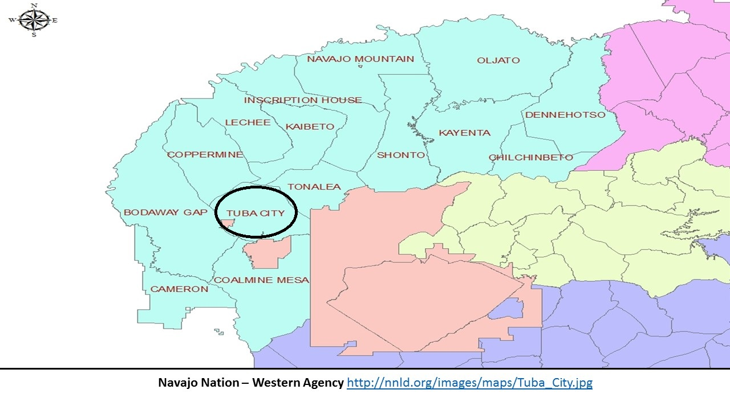
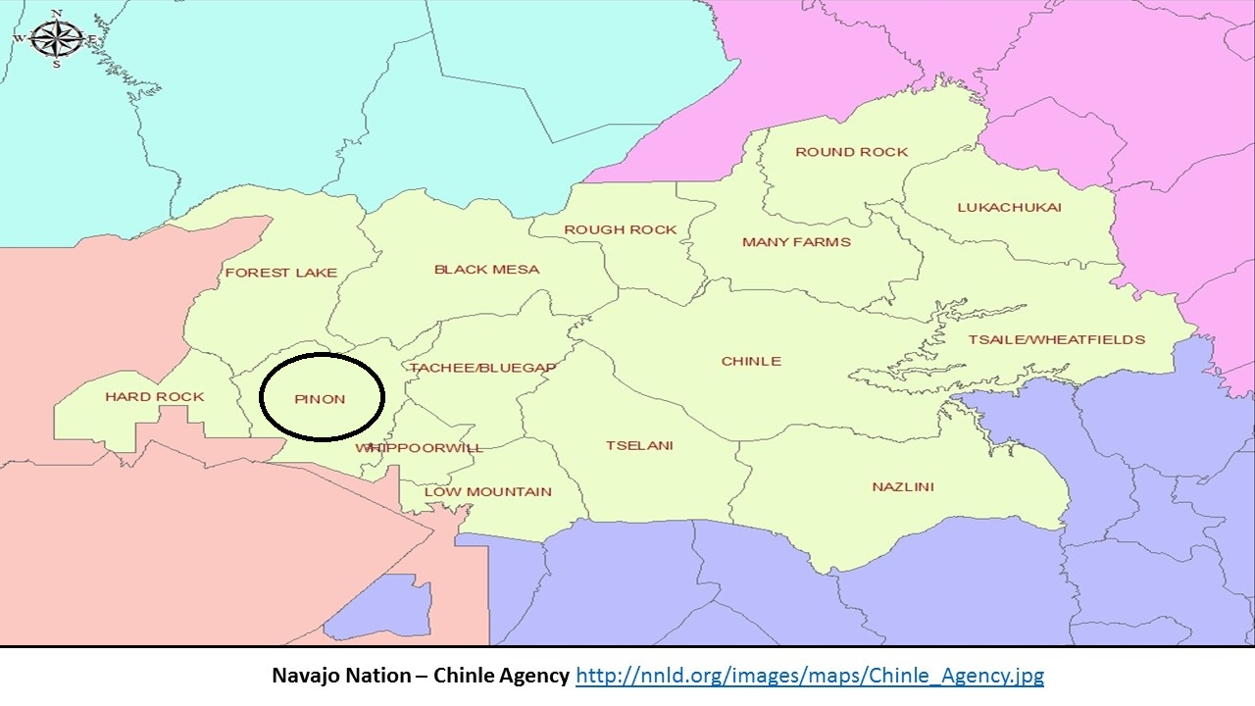
Our current Collaborating Schools for this Project are
Tuba City High School, Greyhills Academy High School, Pinon High School,
Tuba City Junior High School, though we are inviting all HS/ JHS within Navajo Nation

Slide 9
Support letters, consent forms and exit survey copies are attached with our application
Support letters are from: schools, Tuba City Unified District School Board, Tuba City Chapter House and Western Navajo Agency Council
Consent forms will be used for student recruitment
Exit survey will be used to see advancement and improvement of the program

Slide 10
Overall,
This very important community based research project will focus on
(i) providing opportunities for students from underserved communities to pursue careers in biomedical sciences, allied healthcare, and basic or clinical research; and thereby
(ii) positively impacting local workforce development; and also (iii) improving community health literacy in minority communities with health disparities.
A board of advisors that represent strategic constituencies will be comprised of project team members, high school/ junior high school faculty, subject matter experts, community leaders, chapterhouse representatives, and community health service providers. An external evaluator (Rockman et al.,) will assess evaluate the project’s effectiveness of communicating findings to wider audiences.

Slide 11


Slide 12
Thank you

